Slide 1

MALAMULELE ONWARD PROJECT

Slide 2
RECAP FROM LAST SEMESTER
STUDIED FOR EXAMS.
Identified the problem statement.
Considered what technologies we can use.
Discussed pros and cons of the various technologies.
Our client has completed the System Requirements Document and sent it back to us
Translate documents to logical models and technical requirements
Assign roles.
Set up a rough schedule of how (and when) we are going to handle all project dynamics.

Slide 3
LOGICAL MODELS
Use Case Set And Diagram
Fully Dressed Use Case Descriptions
System Sequence Diagrams
Entity Relationship Model

Slide 4
Create (Parent) Facilitator

Slide 5
Create (Home) Visit

Slide 6
Create Workshop

Slide 7
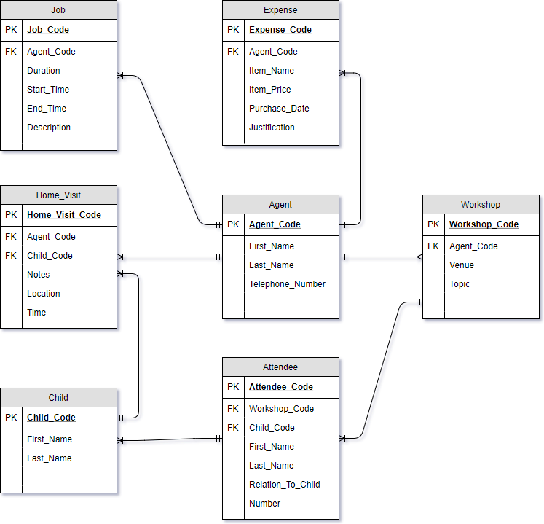
ERD

Slide 8


Slide 9


